Slide 1




Slide 2

BUSINESS ETIQUETTE - GET TO THE POINT –SUMMARIZE YOUR SUBJECT IN THE FIRST PARAGRAPH, BODY – MAKE IT RELEVANT TO YOUR AUDIENCE

Slide 3

What is Business Communication?
Internal or external
Notes:
Business communication is best described as the process of sharing information for the benefit of a business. It's generally categorized as being either internal or external. Internal communication, as the name suggests, occurs when a business shares information within its organization. Consequently, external information occurs when a business shares information outside of its organization, either to clients, customers or vendors.

Slide 4

How to get to the point quickly ?
“I believe that”
Notes:
To easily elevate a topic, title or theme into a point, I recommend using the “I Believe That” exercise. The most successful speakers use it, and it’s incredibly simple:
Imagine your point — the kind you would make to a colleague, boss, client or partner — as a single sentence.
Put the words “I believe that” in front of it.
Ask yourself: Is this now a complete sentence with a clear point?
If you have a complete sentence, you probably have a point.

Slide 5

Impact of your words
Notes:
Once you pass the “I Believe That” test, use the three tips below to ensure that your point is substantial and relevant:
1. Avoid truisms.
A truism is an obviously true statement (e.g., “social media is popular,” “hard work is important,” “ice cream is delicious”), so there’s no use proposing one as your point.
2. Always include the “why.”
“I believe social media marketing is important” is a complete sentence, but it doesn’t explain what makes social media marketing important.
When you have a broad adjective like “important” or “great,” be sure to include a very clear “why” or a declaration of meaningful impact.
3. End with your highest-value impact.
Is your ultimate objective really higher website traffic, more Twitter followers or taller peaks on a data chart— or are those just milestones toward a more important goal?

Slide 6
1. Avoid truisms-social media is popular,” “hard work is important,” “ice cream is delicious, let me know if you need anything,everything happens for a reason,we should hangout sometime, There is more fish in the sea 2. Always include the “why-I believe social media marketing is important 3. End with your highest-value impact.

Slide 7

Without a point everything you say is pointless
Notes:
The perils of not having a point can’t be overstated. You could be the world’s most confident speaker yet fail if you don’t know your point, much less make it. Speaking without a true point is also the greatest cause of rambling, low audience engagement, and epic fail.
Remember that getting to your point, making your point, sticking to your point, and nailing your point all starts with one crucial to-do: Knowing your point.
Joel Schwartzberg is a leadership and public speaking coach whose clients include American Express, Blue Cross Blue Shield, State Farm Insurance and the Brennan Center for Justice. He is also the author of “Get to the Point! Sharpen Your Message and Make Your Words Matter” and “The Language of Leadership: How to Engage and Inspire Your Team.” Joel has written for Harvard Business Review, Fast Company and Toastmaster. Follow him on Twitter @thejoeltruth.

Slide 8
Get to the Point! Sharpen Your Message and Make Your Words Matter

Slide 9

Use an Outline
Notes:
Using an outline can help you to hit all your main points in a logical, cohesive manner.

Slide 10

Review any current data and analytics.
Know your audience on a deeper level-take a survey and collect information-specific product or service-related questions
Notes:
When getting to know your audience on a deeper level, begin by reviewing any current data about this group you’ve already collected. This includes all relevant analyses your company has conducted about your customers since you’ve been in business.
For example, maybe you’ve already held a focus group with real customers who shared their feelings about your product or service. This gives you a starting point to work from when learning about your audience on a deeper level — you already have some understanding of the real pain points and challenges they experience and what they need from your product or service.
From there, consider the other types of audience-related information you’re missing and need to obtain. For example, maybe you create and administer a survey for your audience members to get answers to much more specific product or service-related questions you have for them.

Slide 11

Look to previous successes among your audience.

Slide 12

Create buyer personas
You’ll be able to understand the needs and wants of your audience and customers. They’ll guide your product or service development and allow you to market to your specific audience more effectively.
Notes:
Next, create buyer personas if you don’t already have them. With buyer personas, you’ll be able to understand the needs and wants of your audience and customers. They’ll guide your product or service development and allow you to market to your specific audience more effectively.
As a result of creating buyer personas, you’ll be able to better understand a wide array of reasons why your audience members need your product or service, how you can target and convert them, and create long-lasting relationships with them. Additionally, buyer personas help your entire business — cross-team and cross-function — stay focused on your target audience so you have a larger chance of reaching and connecting with them.

Slide 13
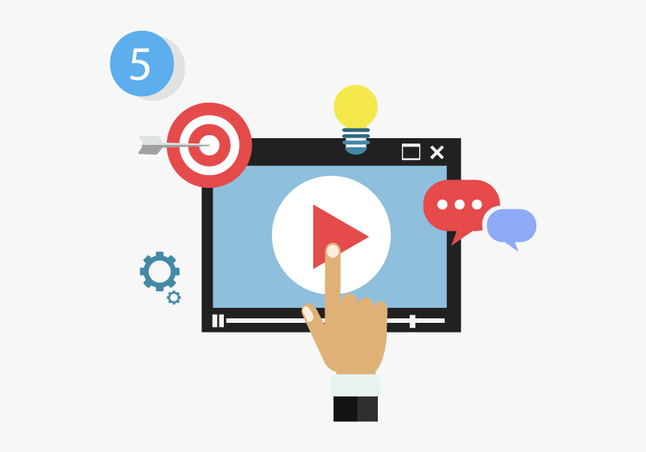
Monitor audience feedback, comments, and engagements.
Notes:
When you monitor a person’s actions and tendencies over time, you learn a lot about what they do and don’t like, what their habits consist of, where and how they seek support, and more — and your audience members are no exception.
Monitor audience feedback over time through feedback, surveys and forms, as well as their comments and engagements on your blog, customer support channels, community web pages and forums, and social media profiles. This will tell you which positive and negative experiences many of them are consistently having so you can resolve the largest issues immediately and maintain the things that are working well for your audience

Slide 14
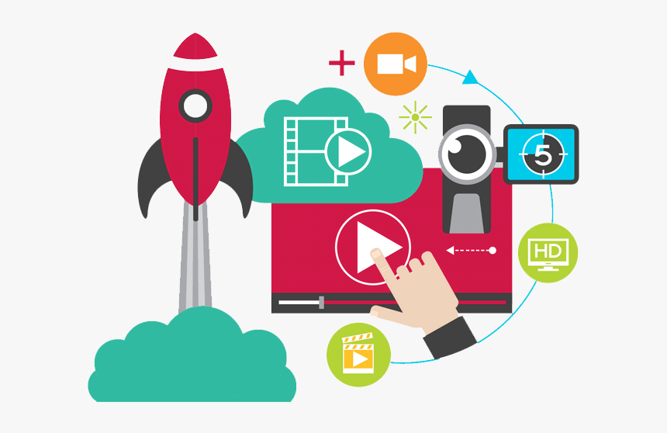
Experiment with content and updates to your products and services.
Notes:
Testing out new ideas among audience members is a great way to determine whether or not your business is effectively evolving with your audience as you grow and create new product or service offerings and features.
For example, maybe your marketing team pitches a plan to reach your audience via an entirely new medium or engineers have plans to update features within your current product or service. If you think these plans are feasible and worth giving a try, go ahead and see how your audience reacts to these changes.
Who knows? You and your team may be onto something that helps you resonate with your audience even more than you already do — and improve retention rates. Or maybe, you learn something simply doesn’t work for your audience, and now you can avoid investing in similar changes in the future.

Slide 15
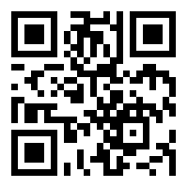
https://learn.codemithra.com

Slide 16




THANK YOU
+91 78150 95095
codemithra@ethnus.com
www.codemithra.com

